Slide 1
Artificial Intelligence and Computer-Related Inventions
Patent Strategy in the U.S.
Thomas K. Scherer
November 24, 2023

Slide 2
What is AI???
Underlying concepts date back to 1950’s
Recent surge due to:
Availability of vast quantities of unstructured data (“Big Data”)
Availability of computing power to process that data
“Intelligence” is likely a misnomer
Ability to recognize patterns in and learn from data gives the appearance of intelligence
Most experts agree that human-like intelligence and reasoning is still far off
Definitions shift as what used to appear “intelligent” becomes routine
“Intelligence is whatever machines haven’t done yet.” Tesler’s Theorem (ca. 1970)
“Machine Learning” is generally considered to be a more accurate term

Slide 3
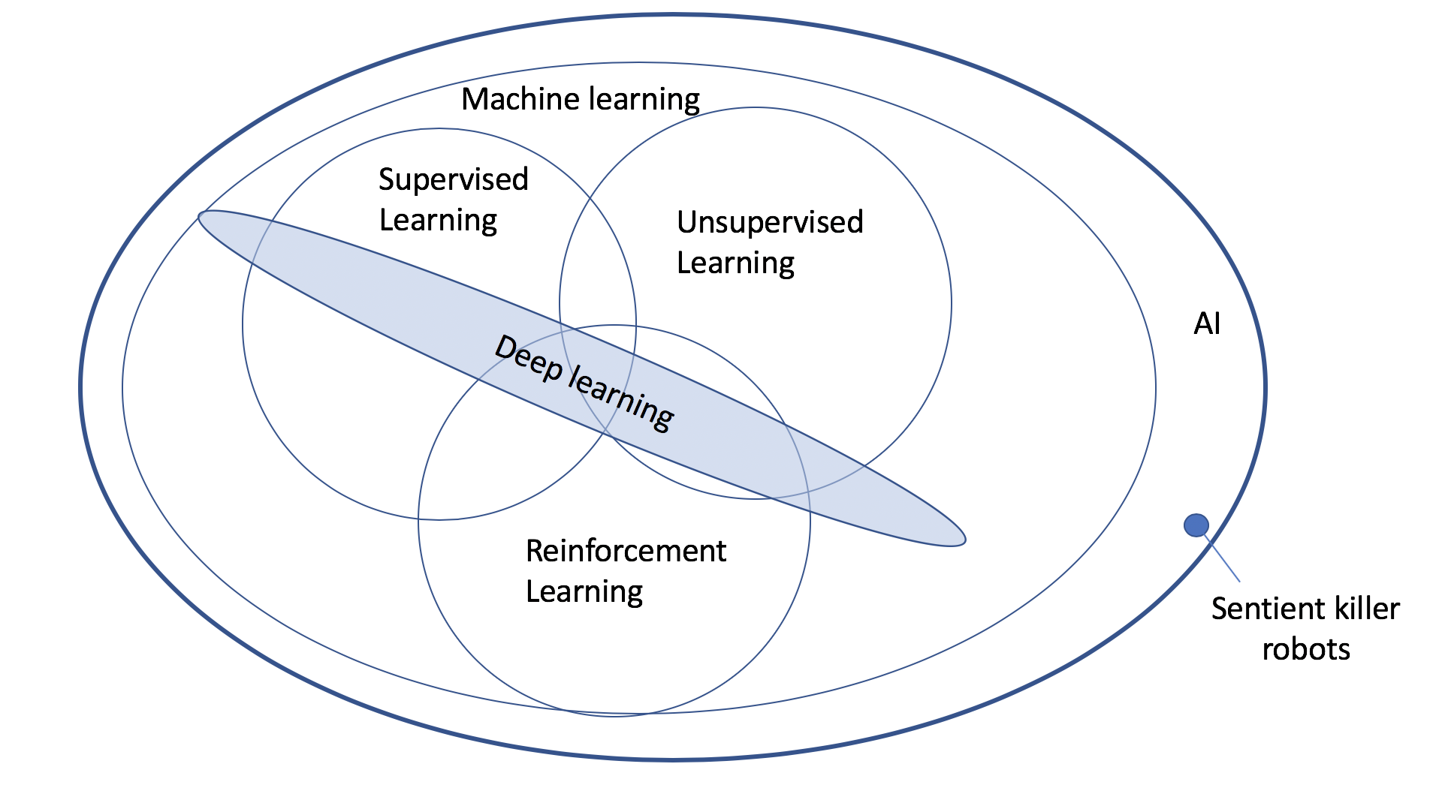
AI Terminology
Courtesy of Dr. Dan Hill, Google

Slide 4
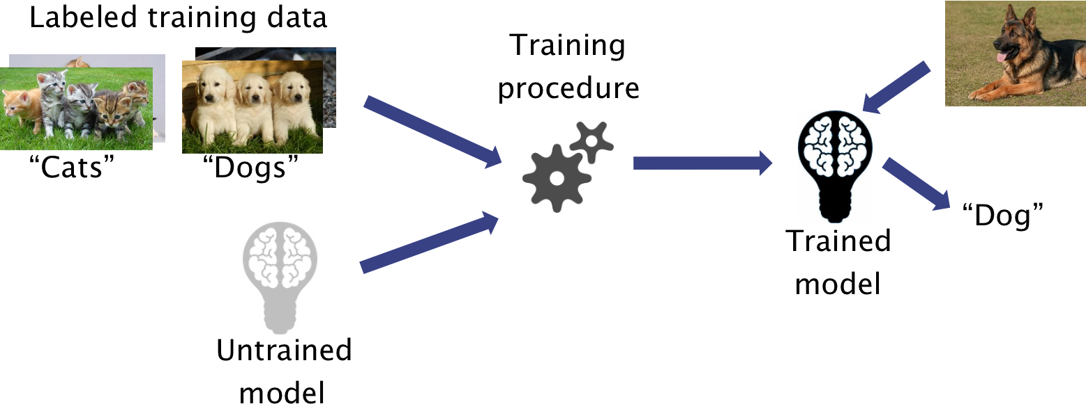
Supervised learning
An ML technique that learns a function for mapping input data to output data using labeled training data
Tasks - regression, classification, ranking
Example - Google Photos image search - https://developers.google.com/machine-learning/practica/image-classification
Another Example – Zillow Zestimate

Slide 5
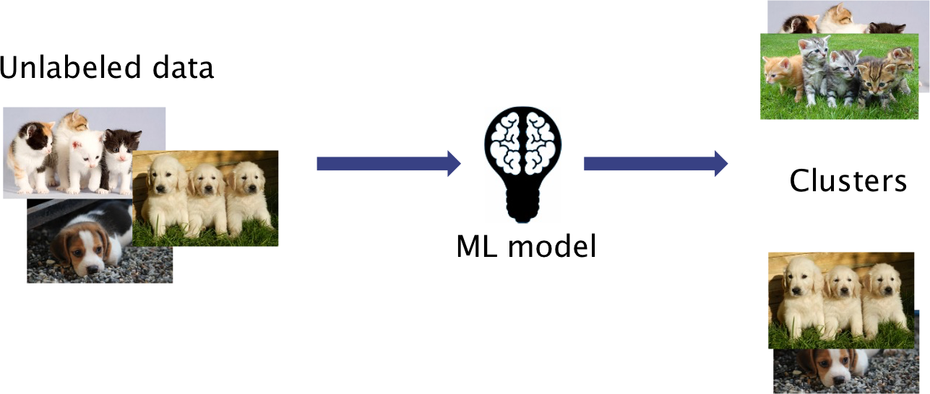
Unsupervised learning
An ML technique that analyzes unlabeled input data to draw inferences, such as detecting patterns
Tasks - clustering, manifold learning, density estimation
Applications - grouping/demographic analysis, principle component analysis (PCA)

Slide 6
Reinforcement learning
A technique in which a machine learns by interacting with an environment through trial and error
Tasks - control, policy learning
Applications - autonomous driving/robot navigation; gaming

Slide 7
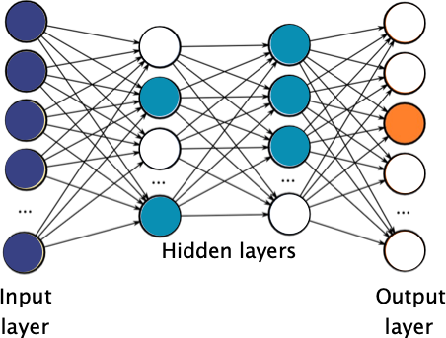
Deep learning
An ML technique that uses artificial neural networks
Algorithms inspired by the structure of the human brain
Can be applied to any of the previously discussed techniques

Slide 8
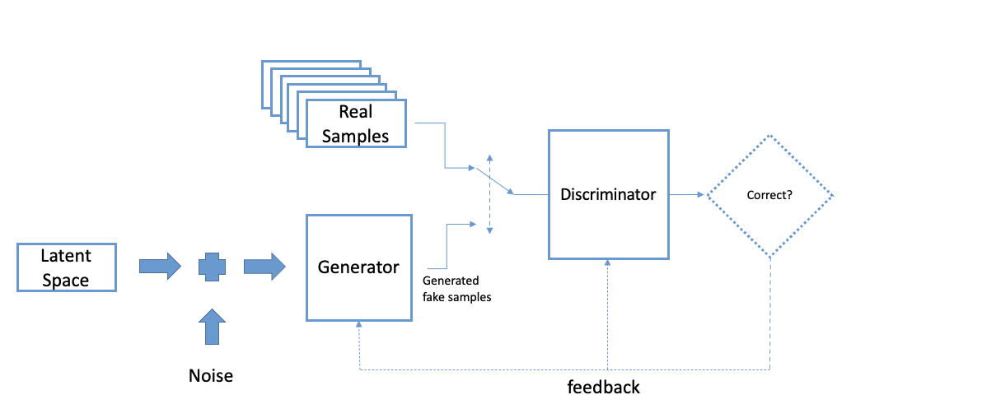
Generative Adversarial Network
An ML technique that pits two deep learning networks against each other
Algorithms inspired by the structure of the human brain
Can be applied to any of the previously discussed techniques

Slide 9
AI and Patents
Problem # 1: the search for common terminology
“Of course AI inventions are patentable! They are just like any other computer software.”
“AI inventions aren’t patentable. Only humans can invent.”
“AI inventions result only from humans using AI as a tool.”

Slide 10
AI inventions at the patent offices
USPTO
CNIPA
EPO
“Inventions that utilize AI, as well as inventions that are developed by AI, have commonly been referred to as “AI inventions.”
“Request for Comments on Patenting Artificial Intelligence Inventions,” published in 84 Fed. Reg. 44889 (Aug. 27, 2019)
Invention patent applications involving artificial intelligence, “Internet+”, big data, and block chain usually contain features of rules and methods for mental activities such as algorithms or business rules and methods.”
“Announcement of Revisions of Patent Examination Guidelines (No. 343)” (December 31, 2019)
“Three categories of AI inventions:
human-made inventions using AI for the verification of the outcome
inventions in which a human identifies a problem and uses AI to find a solution
AI-made inventions, in which AI identifies a problem and proposes a solution without human intervention.”
https://www.epo.org/news-events/in-focus/ict/artificial-intelligence.html

Slide 11
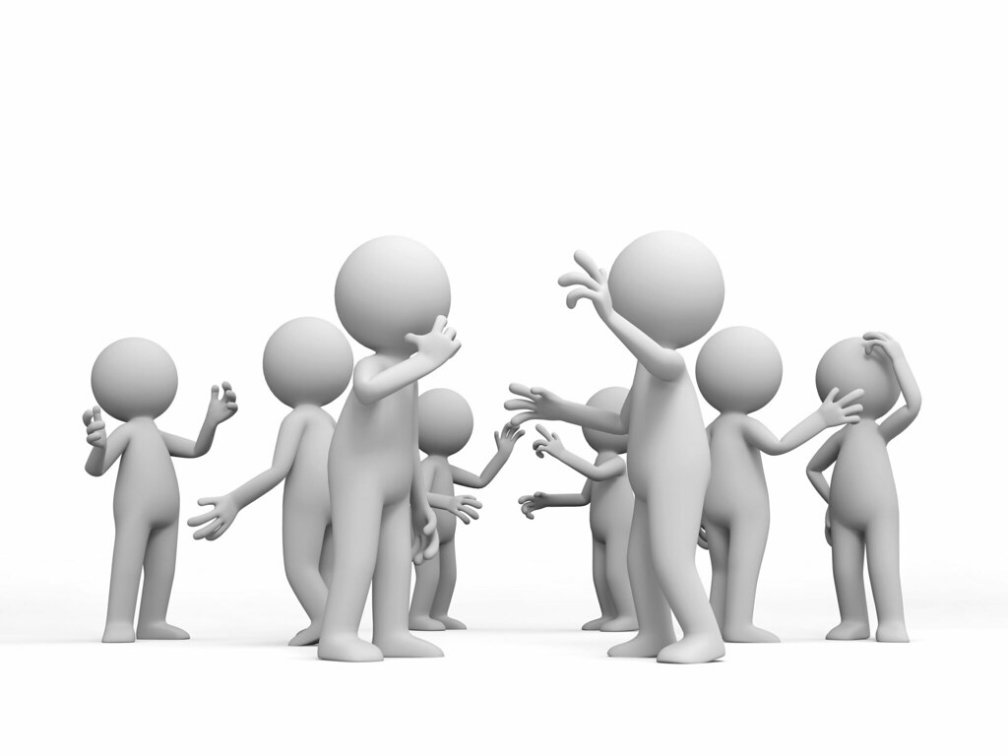
AI and Patents - Issues
What considerations will affect how each Patent Office addresses AI-related inventions
Terminology - Each Patent Office needs to define what it means to be an “AI-related invention”
Collaboration - Each Patent Office needs to work together to create a common understanding with respect to AI
Patentability - Only then, the Patent Offices can work to address substantive issues

Slide 12
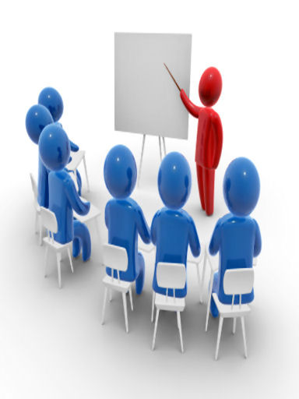
AI and Patents - Strategies
What specifically can we do to facilitate patenting AI-related inventions in the U.S.
Focus the Application - Draft AI cases from a viewpoint of involving AI as a tool that is part of the process (i.e., not a co-inventor)
Creative Claiming - Any “AI-related invention” can be recited in claims similarly to any other computer-related invention
Be Complete - Include embodiments that may not involve AI assistance so as to support the non-AI aspects of the invention

Slide 13
Thank You
Thomas K. Scherer
Partner
Contact Us 联系我们
Tele 电话: +86 571 280 91739
Email 邮箱: info@obwbip.cn

